Slide 1

Network Protocol Analyzers
Comparison of tools and use case

Slide 2

Contents
Protocol Analyzers and uses cases
Wireshark vs tcpdump
1
How it works
2
Protocol Analyzers
3
Use Case
4
Conclusion

Slide 3
Overview
Network protocols
Data get captured and analyzed by sniffing them on Layer 1 – wire level
A process of encapsulation – decapsulation as OSI Models describes occurs
Protocol Analyzers
Wireshark
tcpdump
Use Case
Problem breakdown approach
Bottom-up
Narrowing the scope
Lessons & Answers

Slide 4
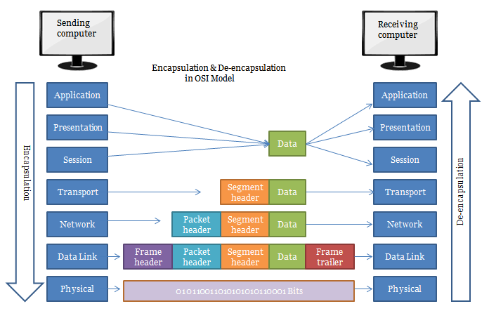
OSI de-encapsulation process

Slide 5
Wireshark vs tcpdump
Criteria | Wireshark | tcpdump
Open-Source | + | +
Easy to use | + | -
Easy to Learn | + | -
Packet Identification analysis & decode | + | -
Efficiency decoding | + | -
Fast setup on the host | + | +
Filters | + | -
Network Interfaces | + | -
Cross-Compatibility | + | -
Flexibility on using live | + | +
Troubleshooting | + | +
Data capture abilities | + | +
Industry Standard | + | +
Product & Community Support | + | +

Slide 6

Wireshark vs tcpdump
It is not about the percentage. It is all about use case and infrastructure
Open-Source
Fast setup on the host
Open-Source
Capture then use on Wireshark
Easy to Learn
CLI
Easy to use
Data capture abilities

Slide 7
Use cases
Network traffic analysis for statistics
Data analysis capture for decryption
Sniffing
troubleshooting
monitoring
And many much more

Slide 8
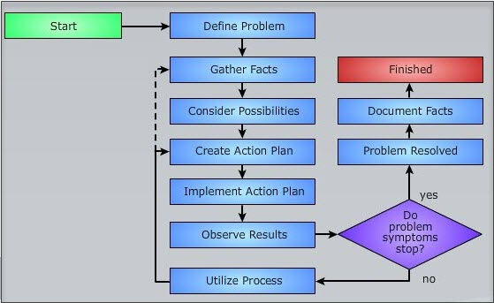
Use cases
Wireshark main use case follows simple
rules of problem solving

Slide 9
Use cases scenario 1
Unreal Engine Packaged Game Development mode client-server Session failure
2 Game Instances on separate machines – client & server fail to communicate with each other on same subnet. Server Successfully creates an online game session but client fails to connect to that listen game instance to be more precise it cannot find any local LAN session at all. (We conclude/assume that the client/server session setup from game-programming perspective is done correctly and there is not misconfiguration in that part but the problem is Network derived)

Slide 10
Use cases scenario 1
Problem Thinking
When we face such problems first, we look into documentation of the framework/game engine to see which IP range the LAN packets are being sent (in which IP the server Listens and the clients should broadcast/multicast).
Let’s assume that we do not have such information for a reason, how we approach this kind of a problem?
Check the 2 Game instances on 1 local machine with a loopback adapter to see if they can successfully communicate join each other and from which IP as outbound/sent interface the multicast (mcast) or broadcast traffic is being generated/pushed-forward (using Network Traffic Analyzers).
Create an isolated Network Environment where broadcast or multicasts packets are being controlled and they are known for each of the service (if you use a regular/normal network environment then the packets will be too many and it will take a while until you recognize the proper ones that being generated from client for a find/join session plus you may introduce network congestion or Computer/program crash if the traffic is extremely high … always try to reproduce the problem under controlled environment)
Use a Network Analyzer to see the Network Traffic that being generated across the Network

Slide 11
Use cases scenario 1
The Solution
Using Wireshark first we performed find/join operations from client game instance on a loopback to first catch the IP address that is being generated … it seems to be a simple broadcast with the pc/host domain name 255.255.255.255
We tried in another network adapters/interface as well such as wi-fi but for a strange reason there were not broadcast packets at all there.
But we detected that in VMware Network Adapter VMNetx (1, 2, 3... etc. depending on configuration) the broadcast packets appeared normally but not in wi-fi
This is more likely to be a Network priority interface problem to validate our thinking we opened a PowerShell session in windows 10 and typed the command: Get-NetIPInterface

Slide 12
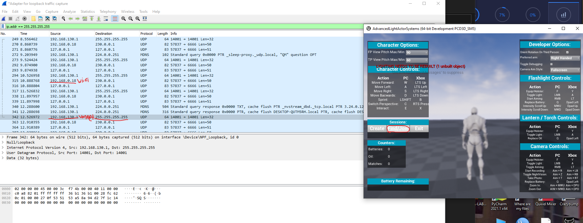
Use cases scenario 1
we can see that in the loopback adapter the interface that the traffic generated outbound was not in wi-fi at all but on vmnet adapter with that in mind we could disable it and try again until we see that wi-fi gets the traffic (priority issue)).

Slide 13
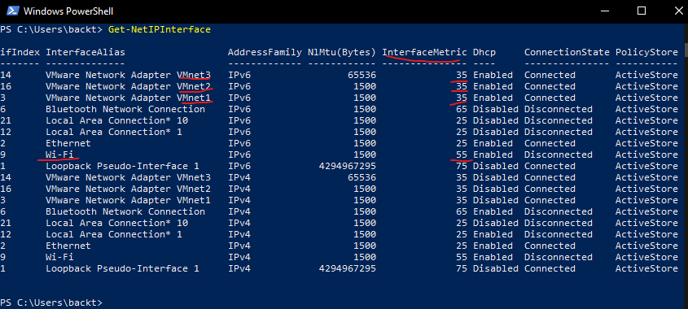
Use cases scenario 1
So, this is the reason that broadcast packets did not select wi-fi adapter perhaps in order to solve this we either disable these interfaces (if it’s safe network operation wise) or change the metric on each one via GUI or CLI command

Slide 14
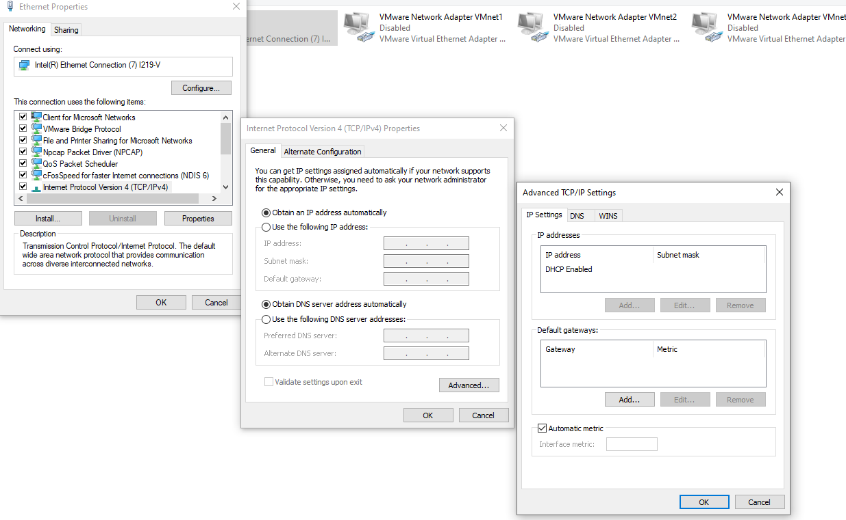
Use cases scenario 1
GUI approach to change interface metrics

Slide 15
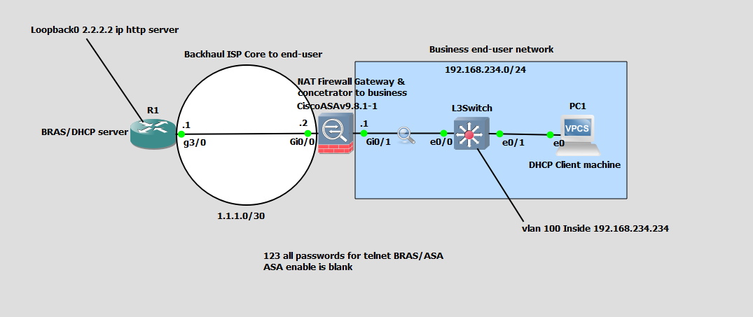
Use cases scenario 2
A network where DHCP process had DO without RA

Slide 16
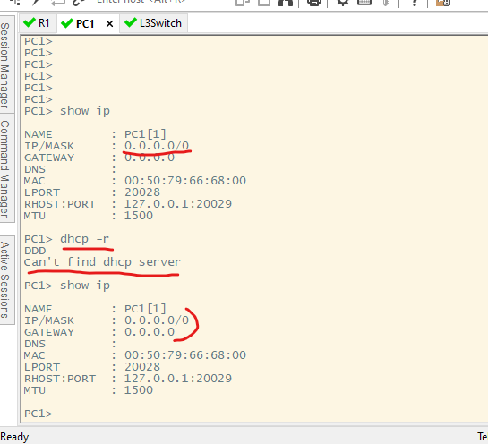
Use cases scenario
Clients’s PC unable to get DHCP offer

Slide 17
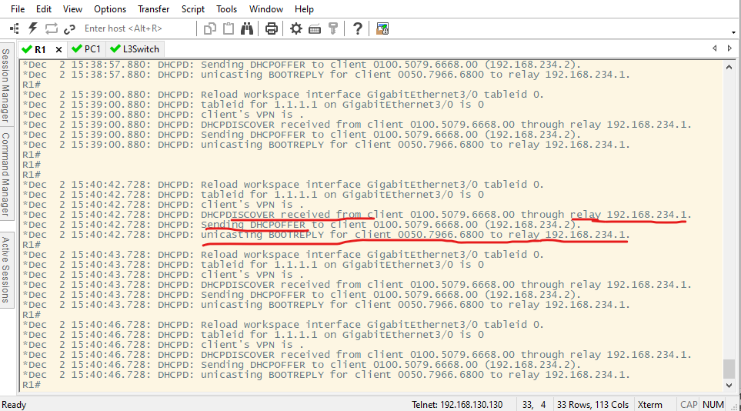
Use cases scenario
Server Logs shows that communication is ok
Up to a point

Slide 18
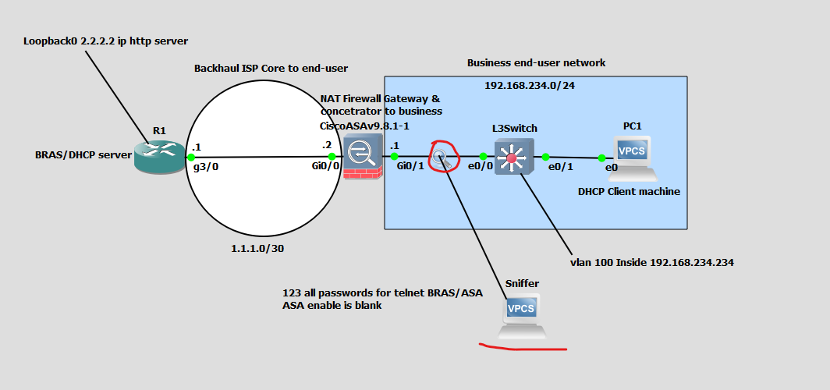
Use cases scenario
Sniffing traffic by following the flow of the packet

Slide 19
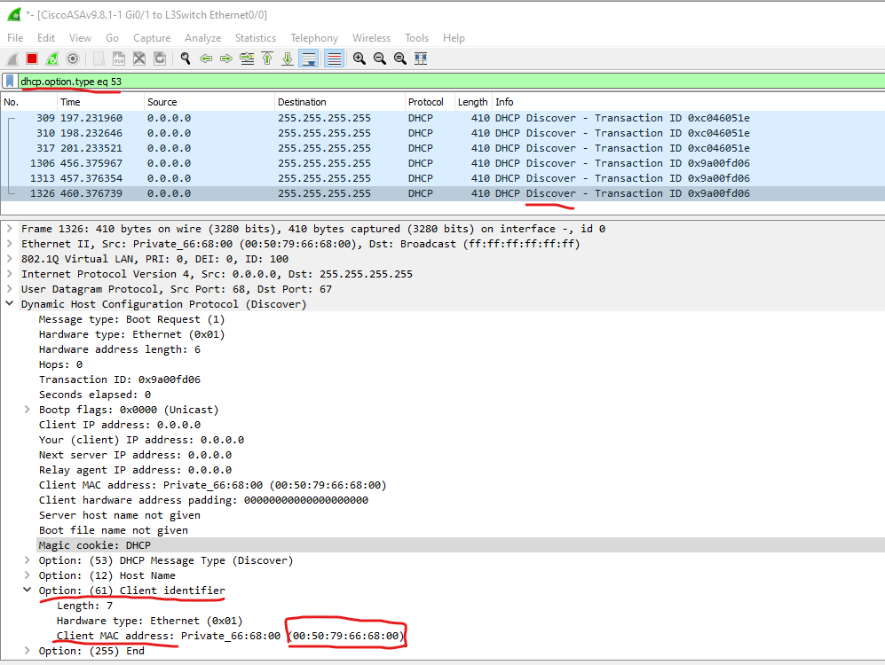
Use cases scenario
Sniffing traffic by following the flow of the packet

Slide 20
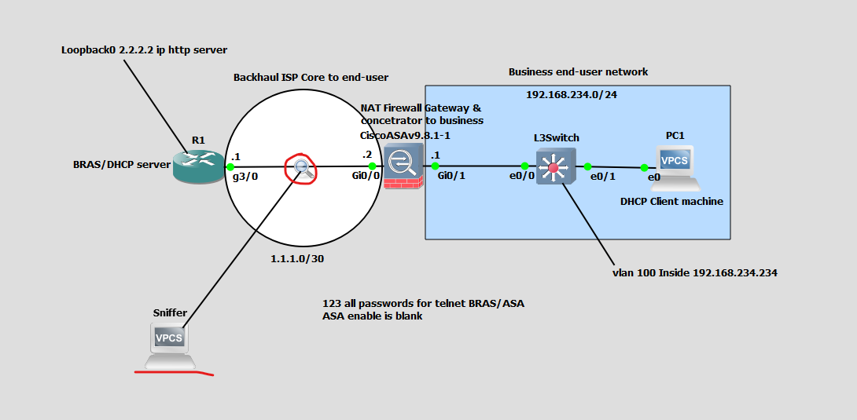
Use cases scenario
Sniffing traffic by following the flow of the packet
In each segment
port forwarding the traffic and capture with Wireshark on top of WAN backhaul

Slide 21
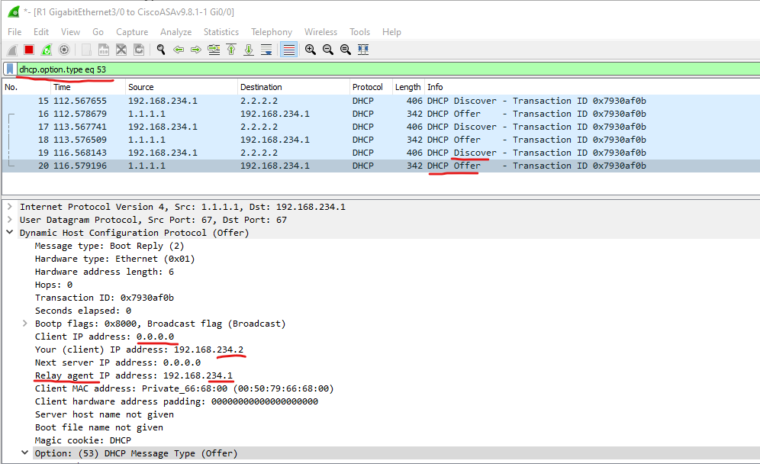
Use cases scenario
Sniffing traffic by following the flow of the packet
In each segment

Slide 22
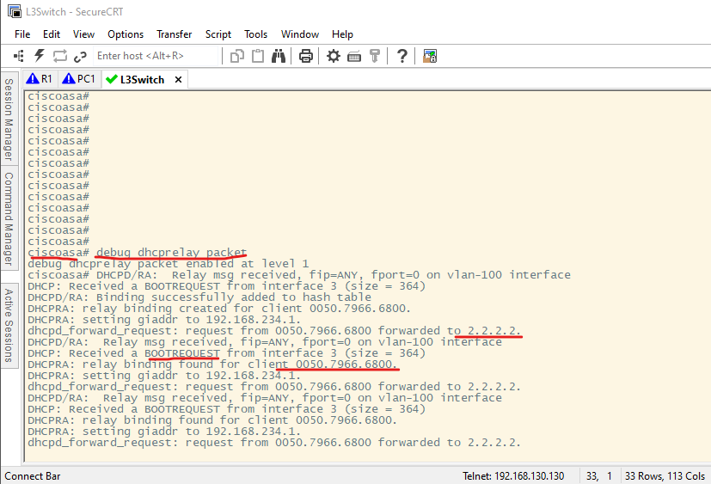
Use cases scenario
Main Firewall debug troubleshooting

Slide 23
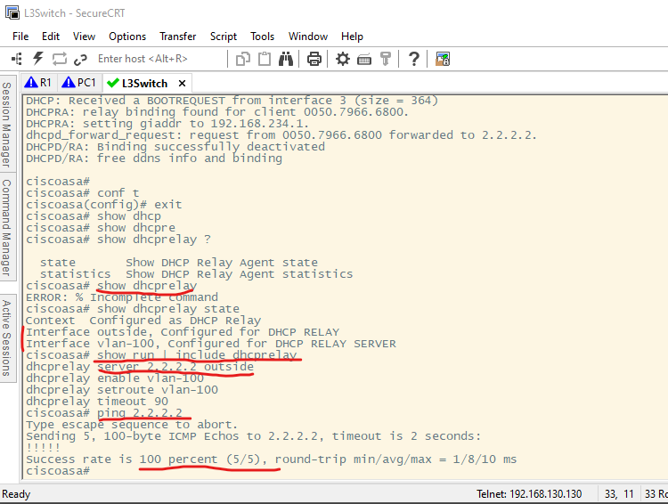
Use cases scenario
Firewall can reach DHCP server thought

Slide 24
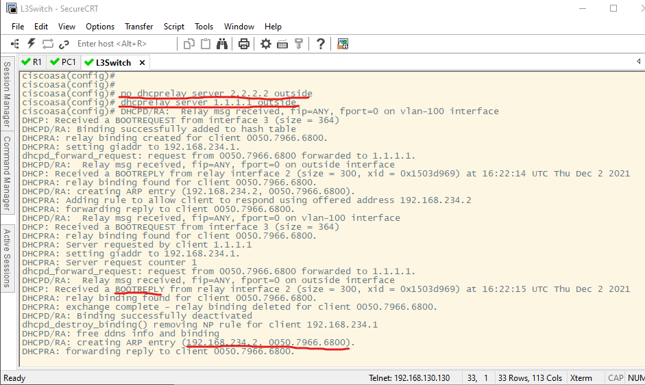
Use cases scenario
Misconfiguration of IP despite that was legit
(It could be reached)

Slide 25
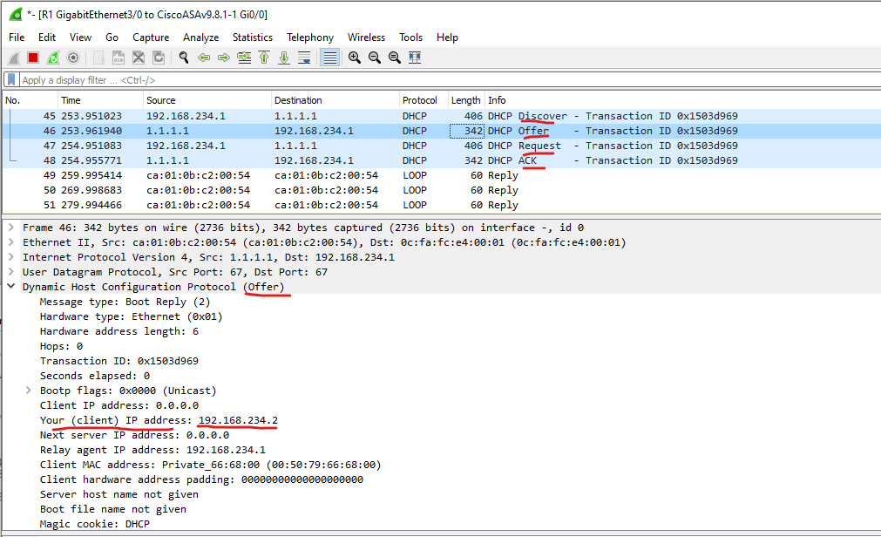
Use cases scenario
DORA SUCCESS

Slide 26
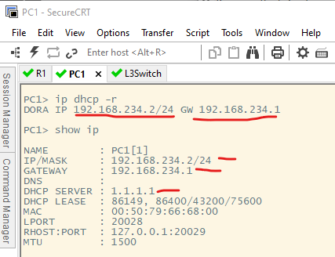
Use cases scenario
DORA SUCCESS

Slide 27
Conclusion
To Use a tool
Its about current infrastructure and design possibilities
To solve a problem
To understand a problem first we understand the application tier error then the network.
Doesn’t matter how big the network is, cut it up into chunks until you close in on the issue, it is like a shortest-route path algorithm logic, actually, this is exactly how an algorithm will work its way through the solution e.g., make neighbours, many times the same way we use to solves agnostic problems.
Trace the problem with appropriate methodology applied e.g., bottom top in OSI/TCP-IP layer [13].
Log the first point of failure
Log the Last Point of failure
Repeat
Wireshark is your friend
Common Logic behavior for problem solving.

Slide 28
Thank You!

